Slide 1


TAU Software Eng Clinic
Development of a Hospital Management System (HMS)
Course
Institution
SEN 322 - Software Engineering Innovation & New Technologies
Thomas Adewumi University, Oko, Kwara State
Student Name
Date
Software Engineering Students
20 May 2026

Slide 2



Project Overview & Agile Approach
Objective
To develop a working Hospital Management System to digitize patient records and clinic access efficiently.
Methodology
Agile framework utilizing Scrum.
Project Scope & Principles
Deliverable: Working increment after two timeboxed sprints of 2 weeks each.
Frequent Delivery: Prioritize delivering functional software consistently.
Adaptability: Embrace change based on feedback.
Simplicity: Maintain a lean, effective approach to solving clinical problems.

Slide 3






Scrum Team Roles
Product Owner
Scrum Master
Development Team
Maintains the product vision for the clinic software. Responsible for creating, refining, and strictly prioritizing the product backlog to maximize value.
Serves as the facilitator. Ensures adherence to the Scrum process, protects the team from external distractions, and rigorously removes developmental impediments.
A self-organizing, cross-functional group responsible for delivering the product increments. Coordinates work by discussing tasks daily and reaching a consensus.

Slide 4
Product Backlog (High-Level)
Definition: The product backlog is a dynamic, prioritized list of what needs to be done to complete the development of the product.
PBI 1 As an active personnel (Doctor/Receptionist), I want a secure login interface with role selection and a passcode to access the system.
PBI 2 As a Receptionist, I want a dashboard to view the patient directory.
PBI 3 As a Receptionist, I want to add a new patient to the system.
PBI 4 As a Receptionist, I want to search for patients by Reg No, Name, or Phone.
PBI 5 As a Doctor, I want to view patient details including age and specific allergies.

Slide 5
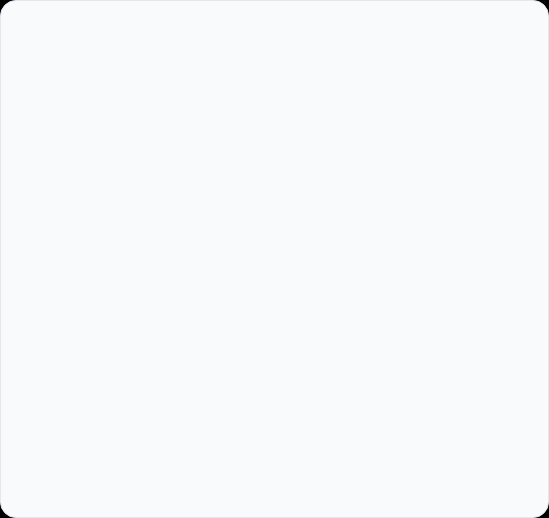

Sprint 1 Plan: Authentication & Foundation
Sprint Parameters
Sprint Backlog Items
Sprint Goal: Establish the application foundation, setup UI layout structure, and implement a secure clinical login system.
Setup Netlify hosting environment and initialize GitHub repository.
Build the initial landing page for "TAU Software Eng Clinic".
Duration: 2 Weeks (Strictly Timeboxed).
Focus: Security, Routing, and Infrastructure.
Implement PBI 1: Role-based dropdown (e.g., Doctor, Receptionist).
Implement PBI 1: Secure passcode entry and "Unlock Ledger" authentication.

Slide 6
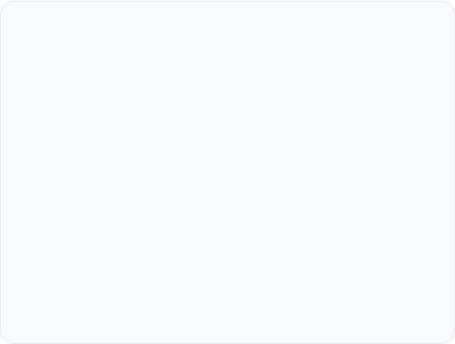
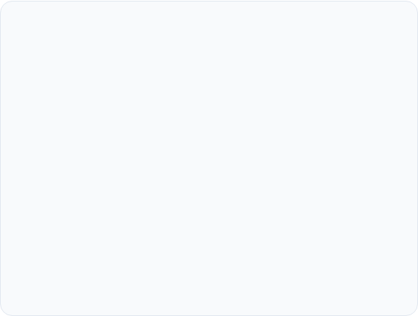
Sprint 1 Execution & Review Notes
Execution: The development team collaborated to implement the chosen sprint backlog items over the 2-week iteration.
Successes
Challenges & Actions
The UI design for the login page flawlessly matches the clinic's branding and requirements.
What went wrong: Role-based routing and secure state persistence took slightly longer than initially estimated.
The CI/CD pipeline functioned correctly, resulting in a successful Netlify deployment on the first attempt.
Actionable Improvement: Allocate more detailed discussion time for state management architecture during the next sprint planning session.

Slide 7

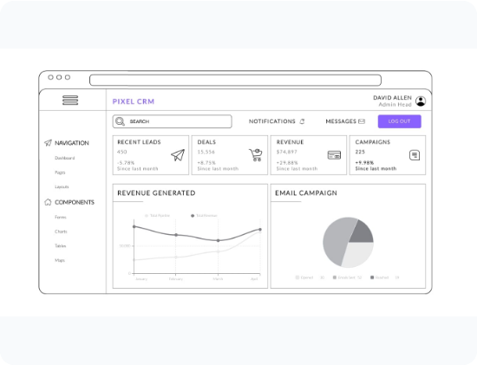
Sprint 2 Plan: Receptionist Dashboard
Sprint Goal
Develop the core functionality for the Receptionist role to effectively manage the patient directory and registrations.
Sprint Backlog Selected
PBI 2: Create the "Receptionist Dashboard" UI with navigational tabs.
PBI 3: Build the "+ New Patient" data entry form and validation.
PBI 4: Implement search bar functionality filtering by Reg No, Name, or Phone.
PBI 5: Design Patient directory list cards displaying vital data (Phone, DOB/Age, and Allergies).

Slide 8
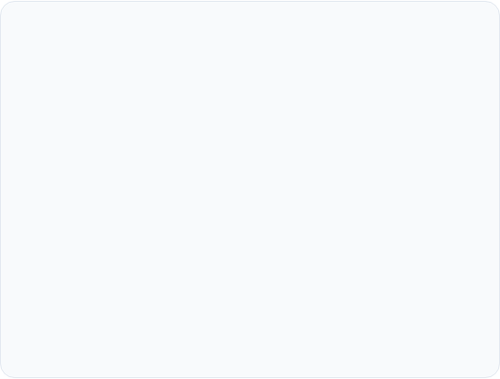

Sprint 2 Execution & Review Notes
Execution: Successfully integrated the patient directory with the frontend interface. Unfinished non-critical UI tweaks were returned to the product backlog.
Successes
Challenges & Results
The search query filters efficiently, handling multiple data points without latency.
What went wrong: Handling the responsive layout for complex data tables on smaller mobile screens required extra, unplanned refactoring.
Patient records displaying distinct allergy warnings (highlighted in red) provide immense and immediate clinical value to the practitioners.
Outcome: Despite UI challenges, a potentially shippable, highly functional product increment was successfully achieved.

Slide 9

Delivered Product Increment
Increment Delivered After Sprint 2
The culmination of our agile cycles resulted in a robust, live application encompassing:
V1.0
A fully functional web-based Hospital Management interface hosted securely at tau-software.netlify.app.
SHIPPABLE INCREMENT
A resilient and secure personnel access portal.
"Output of the sprint that is of high enough quality to be deployed for customer use."
A functional Receptionist Dashboard with a working Patient Directory.
An intuitive Checkout/Billing Queue navigation structure for future extensibility.

Slide 10

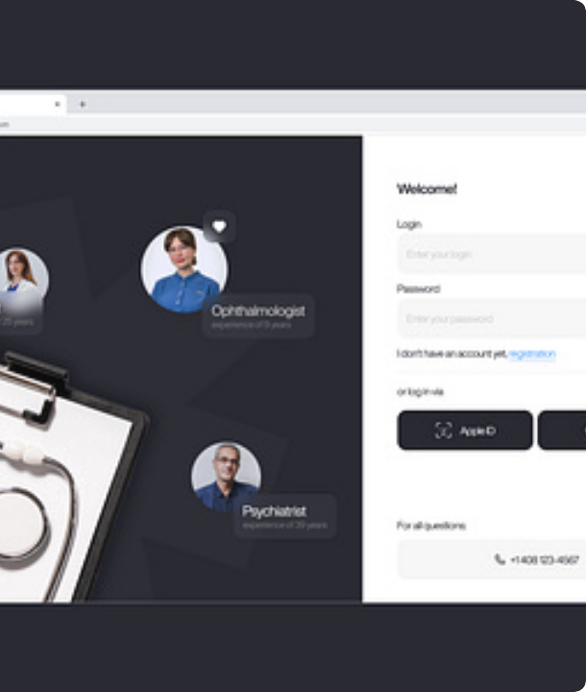
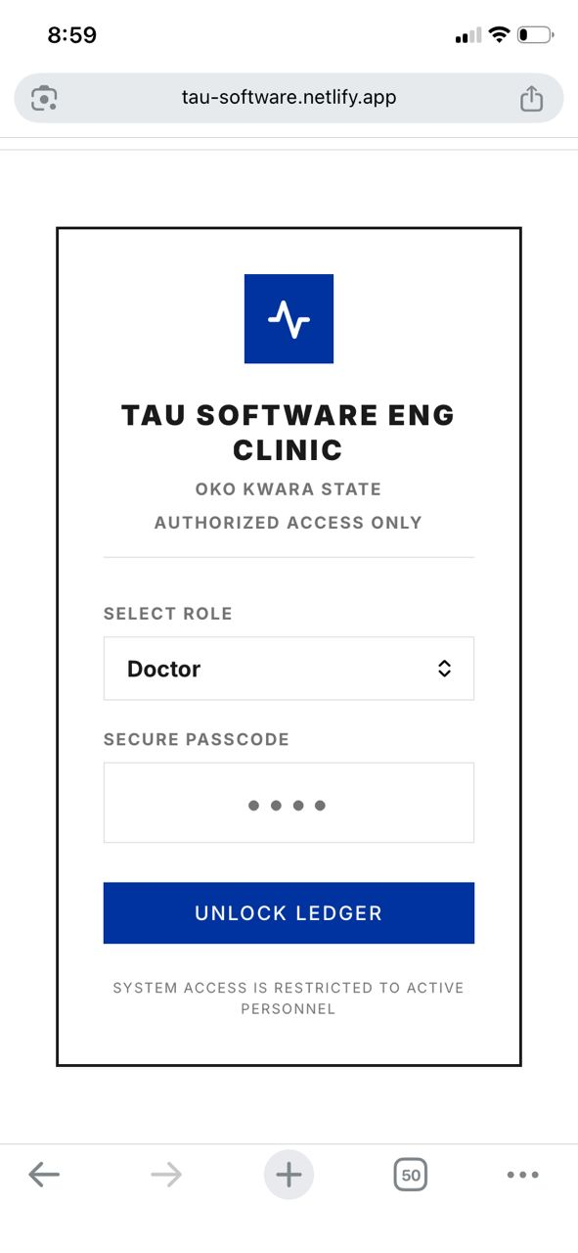
App Showcase: Secure Authentication
The landing and login portal designed specifically for active medical personnel, ensuring strict access control.
Clear clinic branding ("TAU Software Eng Clinic")
Intuitive Role Selection dropdown
Secure 4-digit passcode masking
"Unlock Ledger" restriction logic

Slide 11
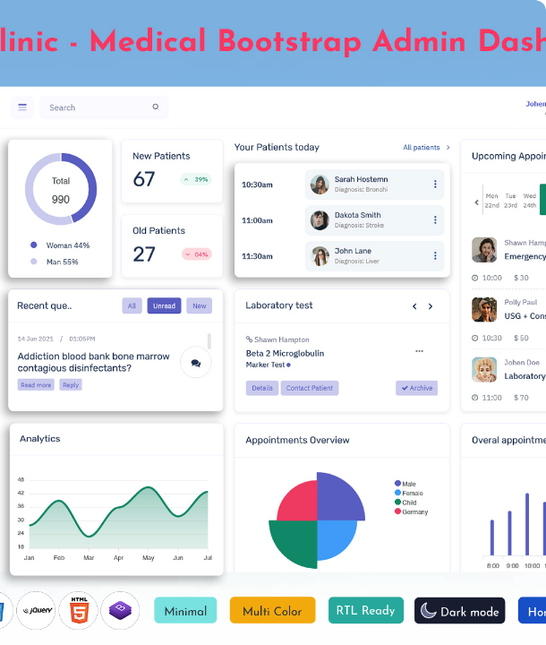
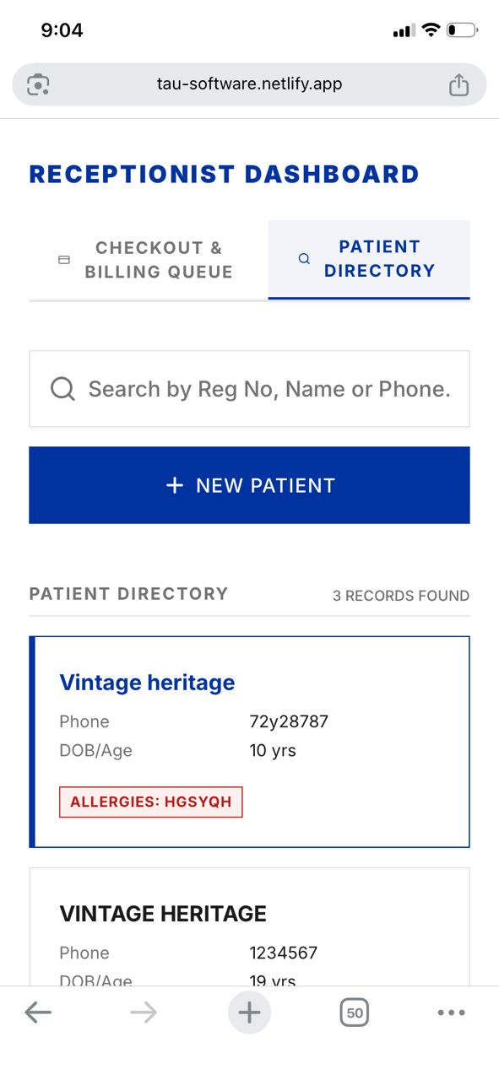
App Showcase: Receptionist Dashboard
The core operational hub for clinic receptionists, optimizing patient data management.
Navigational Tabs (Billing Queue vs. Directory)
Dynamic, multi-parameter search functionality
Prominent "+ New Patient" CTA button
Patient Cards with critical health/allergy alerts

Slide 12






Agile Manifesto Application
Individuals & Interactions
Working Software
Responding to Change
We actively prioritized team collaboration and daily communication over strict processes and tools during our stand-up discussions.
We focused our energy on delivering a functional, value-driven web app over producing exhaustive, static documentation.
We remained flexible, adapting our UI layouts continuously based on the feedback received during sprint reviews.

Slide 13

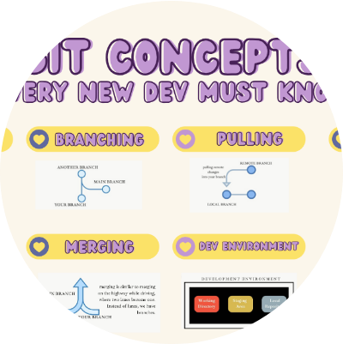


Project Artefacts & Source Code
Access our Deliverables
All project files, historical data, and live deployments have been securely stored and published.
Artefacts Shared:
Product Backlog file (CSV/Excel)
Sprint 1 & 2 Planning documents
Sprint Review Notes
Presentation slides (PPT/HTML)

Slide 14



System Demonstration
Click play to view the live demonstration of the TAU Software Eng Clinic system, featuring secure login and patient search functionality.

